Slide 1
Central and South Pacific
By : Lin F, Miracle S, Tanzina S, Farzan F

Slide 2
Intro to region
Infrastructure
The Pacific Islands lack infrastructure and investment. This leads to a poor economy, lack of jobs, and ineffective local government.
History of Earthquakes
The world’s greatest earthquake zone is found along the Pacific Oceans. This is the main reason why the central and south pacific islands are known for numerous earthquakes. About 81% of the world’s largest earthquakes occur here.
Population
Pacific Islands have a combined population of about 2.3 million people, scattered across an area equivalent to 15% of the globe’s surface.

Slide 3
How Common Are Earthquakes?
Earthquakes in the Central and South Pacific region are extremely common. To give you a feel about how common they are, here are some statistics of the recent earthquakes:
1 earthquake in the past 24 hours (as of July,16, 2020)
16 earthquakes in the past 7 days
115 earthquakes in the past 30 days
1,043 in the past 365 days. (That’s only a year’s worth!)

Slide 4
Are there Notable Major Earthquakes?
Within recent years, there have been several major earthquakes. In 2018, the was an 8.2 magnitude earthquake in the Pacific ocean off the coast of Fiji and was reported to have been 560 km deep.
On June 23rd of this year, there was a another major earthquake of 7.4 magnitude in southern Mexico and caused a tsunami to occur in nearby Pacific coastal areas. It also resulted in the deaths of one resident and buckled many roads.
One of the world’s largest earthquakes since 1900 occurred in Sumatra, Indonesia. It was a 9.1 magnitude earthquake and resulted in the death of 227,898 people, the displacement of 1.7 million others, and caused tsunamis in 14 countries in South and East Asia.
Notes:
Mine

Slide 5
Other Seismic Activity:
As well as having a history for having the largest number of earthquakes and the most damaging earthquakes, the Central and South Pacific region is also known to have the most seismic activity per area. This region receives…
Violent floods
Volcanic activity
Tsunamis
Typhoons
All these natural disasters are caused by earthquakes
t

Slide 6
How Prepared/able to Rebuild is your Region:
Earthquakes are one of the natural forces that man made technologies are not resistant to. To prevent damages to the community, engineers have developed ways for buildings to receive less damage to its structure.
The first method was to create a building on an isolated flexible base. The building is built on flexible pads, so when an earthquake hits, only the base shakes with the waves and keeps the building stationary.
Another method is to embed shock absorbers to decrease the magnitude of the shockwaves.
The last method is to redirect the seismic waves away from the the buildings. By placing concrete and plastic rings around the buildings, the waves will pass through the rings without disrupting the building. t

Slide 7
Are all communities in your region affected equally?
Since countless earthquakes occur all over this region, all communities should be affected equally. However, depending on location and distance from tectonic plates certain areas will be affected differently.
For example an area near a tectonic plates would have more collateral damage than an area that's further away from the plates.
And depending on the wealth of the community, some communities would be more prepared.
Notes:
mine

Slide 8
Project Goals And Why Coding Helps
Our goal is to effectively teach others information regarding earthquakes in the Central and South Pacific region.
Coding helps allow us to understand the intensity, location, magnitude, and aftermath of earthquakes.
Coding enabled us to efficiently map earthquakes within the last century and we saw important trends in the data as result.
We also were able to observe important trends in the data.
Notes:
mine

Slide 9
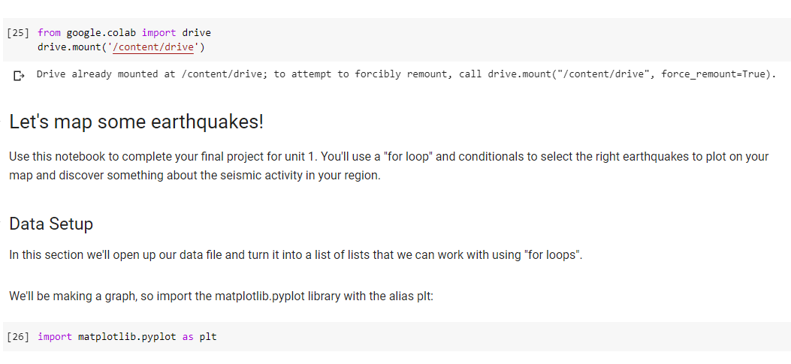
Our Code

Slide 10
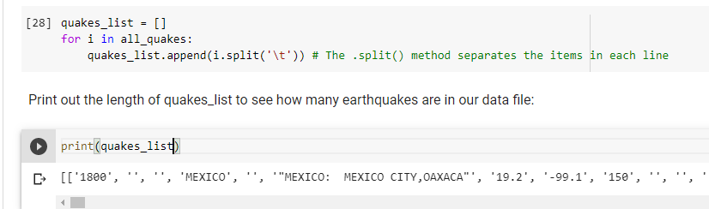

Slide 11
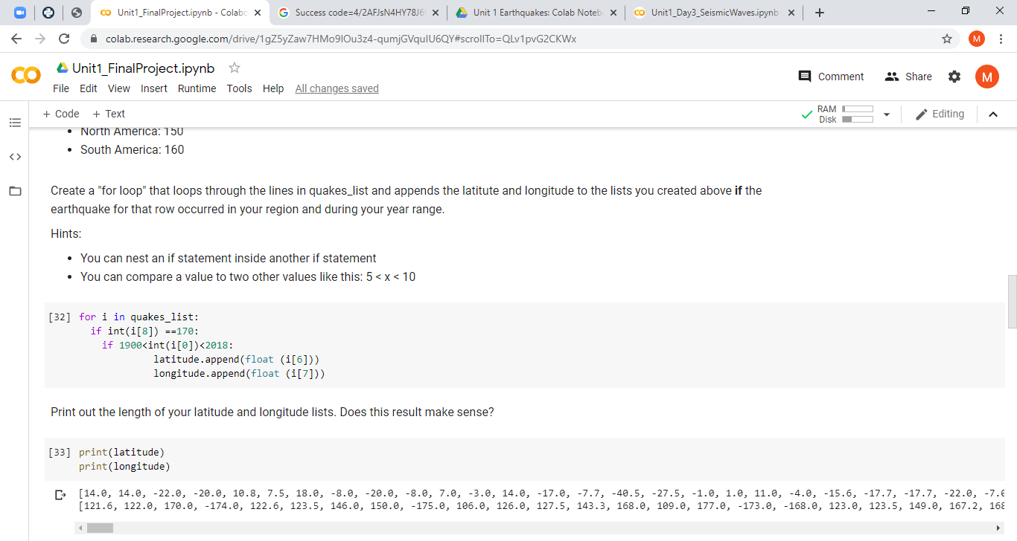
t

Slide 12
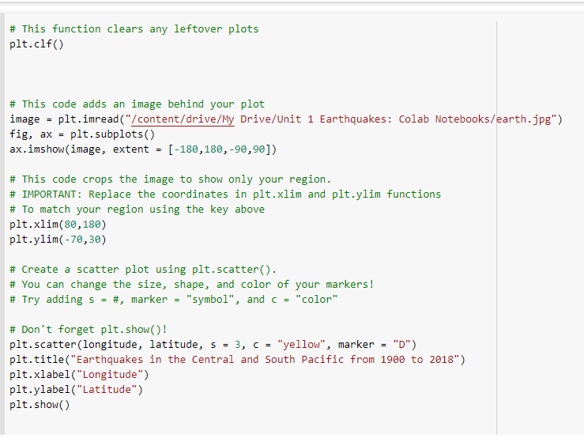

Slide 13
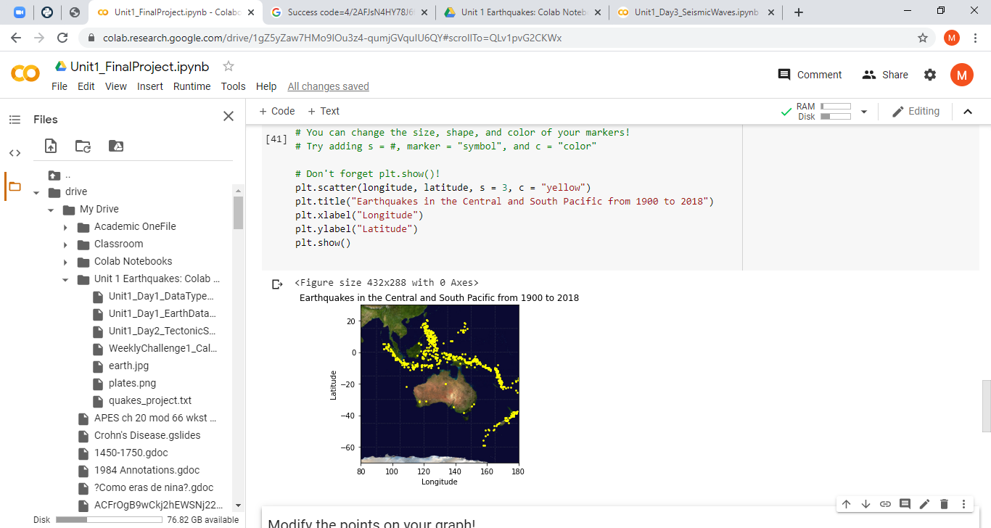
As you can see a large number of the earthquakes occurred along the Ring of Fire.
Notes:
There is a lot plate movements in this area
mine

Slide 14
Challenges/Solutions
Coding the map was one of the hardest challenges we faced today. This map was a bit different than the previous graphs we coded because it involved different factors. The order of the lines of code were mixed up as well, causing the map and image to split and different colors to be plotted. But we were able to overcome these challenges by making small changes until we got a perfect graph.
t

Slide 15
Conclusions
From our lines of code we were able to create a visual representation of the earthquakes in the Central and South Pacific as well as longitudes and latitudes. The locations showed all of the earthquakes the occured from the 1900s to 2018. We first made the list of the earthquakes and filters the information through region number and timestamps. From this code we were able to learn the intense frequencies of earthquakes on the Central And South pacific areas

